Slide 1
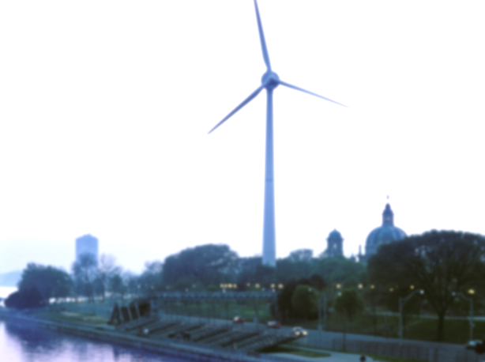
Towards sustainable integrated energy systems – distributed low emission production, storage and smart grid
Jukka Paatero Aalto University Department of Energy Technology jukka.paatero@aalto.fi
HELTSTACK 8.5.2015

Slide 2
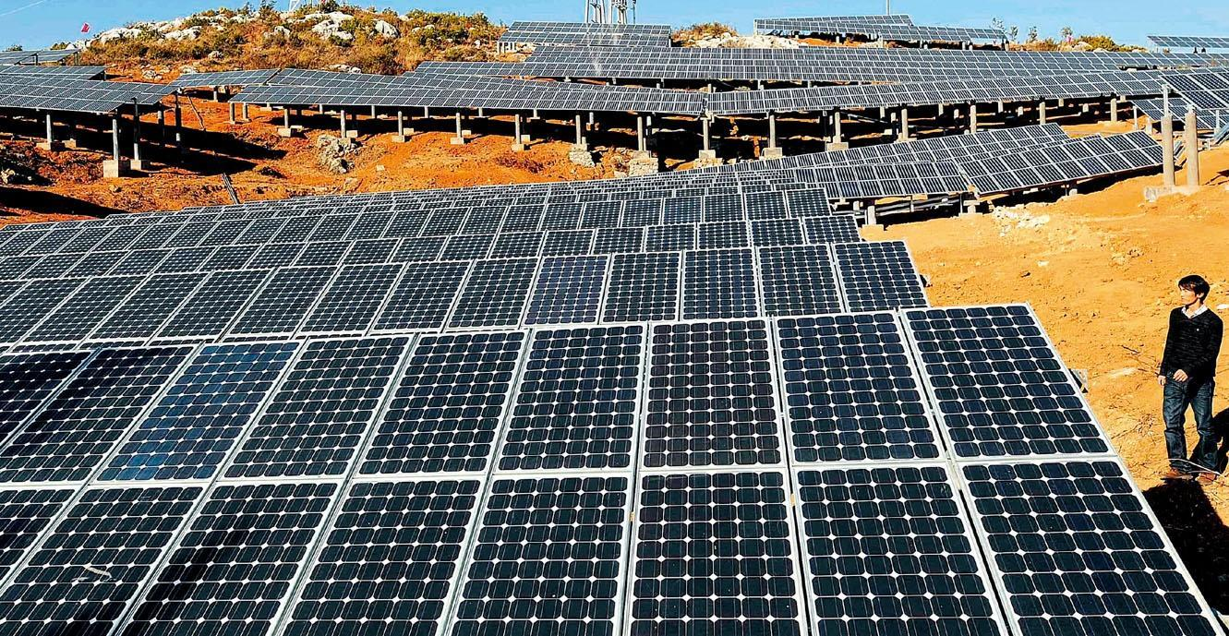
Main Themes
Towards Distributed Energy Production
The Change in Grid: Getting Smart
The Change in Affordability: Case Solar
What Slows Down the Transition

Slide 3
Towards Distributed Generation – Why?
NEW TECHNOLOGY: opportunities for DG and the new smarter grid
INVESTMENTS: improving cost benefit ratio of DG vs. cost intensity of traditional energy systems
NEW ENVIRONMENT: the steps towards low carbon society

Slide 4
Distributed Generation Technologies
Distributed Generation / Source: VTT

Slide 5
The Transition in Hierarchy

Slide 6
Grid Getting Smarter
! All the needed technology is already available !

Slide 7
New Needs: Low Energy Communities
Lower energy needs
New opportunities for local solutions
Mindset open for new solutions

Slide 8
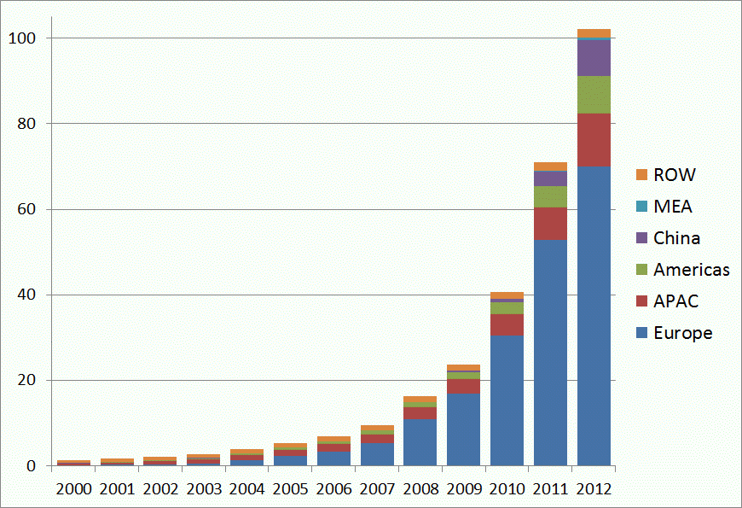
Technology Development: Case PV
GW
Global installed PV capacity follows exponential growth as in S-curve type growth

Slide 9
Price Development of DG: Case Solar

Slide 10
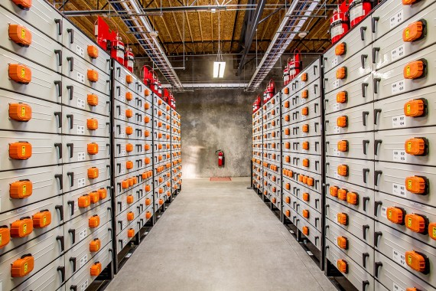
Grid Scale Electricity Storage is Here
MW-scale lithium battery storages
Fleets of electric vehicles = massive smart grid opportunity
Balancing issues with large penetration of variable DG solved?

Slide 11
What Slows Down the Transition?
Huge long term investments in existing infra => money talks!
Advocates of new energy thinking are often not present in urban planning processes
Novel solutions must be easy to use and maintain => or simply invisible

Slide 12
Conclusions
New environment for energy business is around the corner
Local is global also with energy
The new energy players are many:
small wind, photovoltaics, micro-CHP, smart tech apps and novel storage

